Slide 1

Food Techies
Bhoopesh
Simranjit
Osheen
Prajakta K

Slide 2
Introduction
Meal delivery system is built with meal order and customize meal options.
This system would be specifically suitable in college campuses where multiple suppliers can register and provide various services to the users.
Users can either order by quick meal or can customize the meal according to ingredients of their choice.
User can also receive alerts about the status of their order
Suppliers can add recipes and provide them to users along with providing alerts to the user.

Slide 3
Project Overview
Existing systems which provide meal delivery services either have the customize food option or the delivery and take out service.
Some websites provide recipes of food items which can be prepared with user choices while others have an option of delivering the predefined recipes.
Food-Techies- Integration of both the customize and meal delivery options is provided. Several suppliers can provide this service, all under one roof. Additionally, suppliers not only provide predefined food items, they also provide the customized meals.

Slide 4
How we built it?
Languages used- Python, Flask, HTML, CSS, JavaScript, AJAX, jQuery
Database used- Sqlite3
External Libraries-twilio, sets

Slide 5
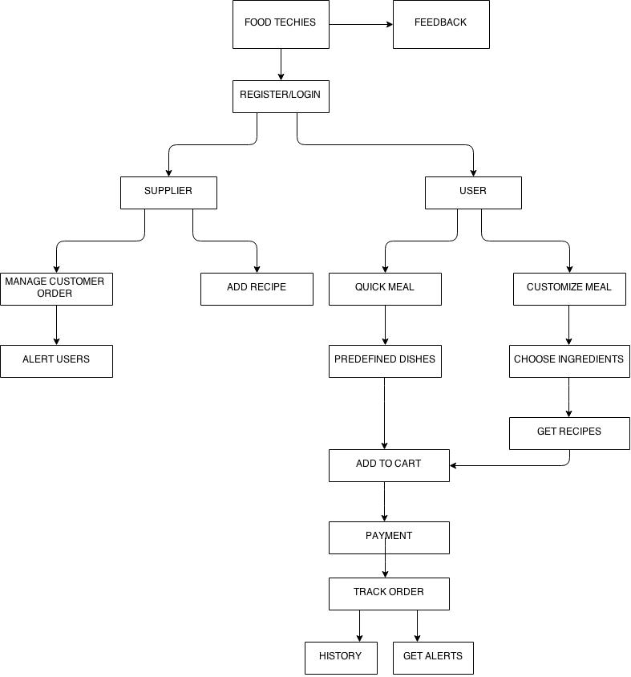
FLOW CHART

Slide 6
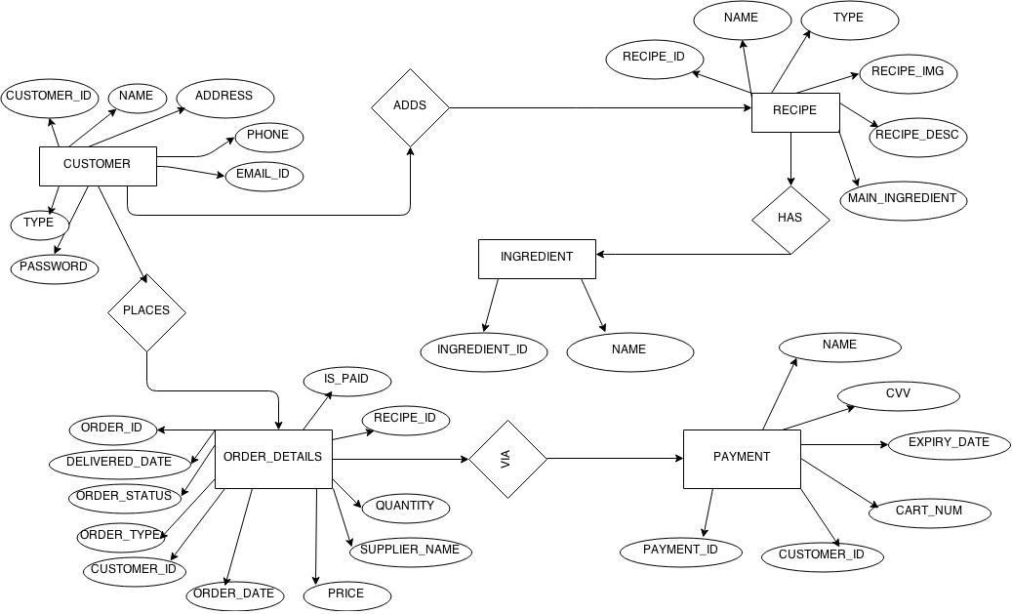
ER DIAGRAM

Slide 7
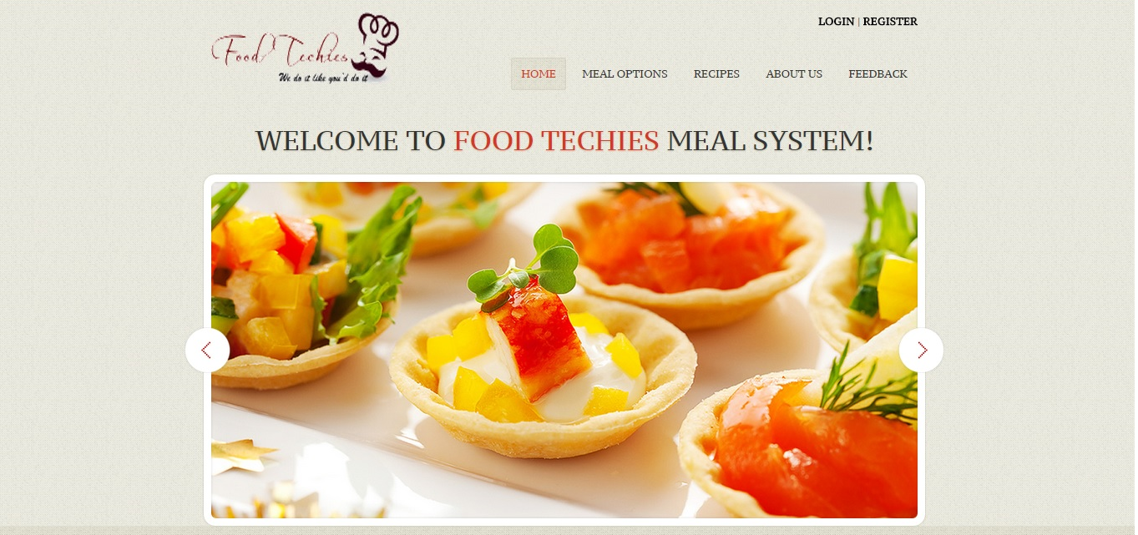

Slide 8
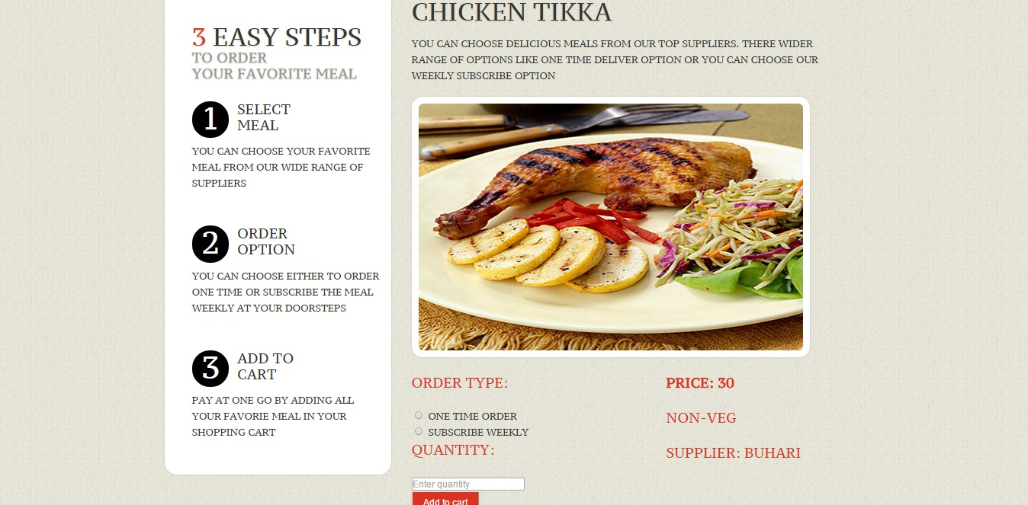
Order Meal

Slide 9
Limitations & Future Scope
Database entries are limited
Improved security in the payments
Improved registrations through captcha
Suppliers can be registered location wise, and further the application can be used anywhere

